Slide 1


Transport Layer Security (TLS)
Course Name: Computer Networks
Course code: ICT3201
Presented By | Supervised BY
Name: Kuldip Saha Mugdha ID: IT-22018 3rd Year, 2nd Semester Session: 2021-2022 Dept. of ICT, MBSTU | Mr. Dr. Nazrul Islam Associate Professor Dept. of ICT MBSTU

Slide 2

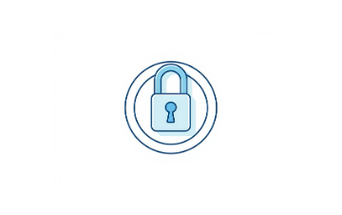
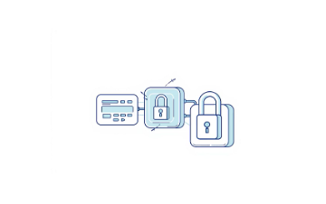
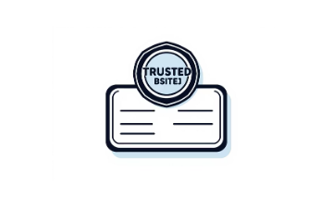
What is TLS? The Foundation of Secure Communication
Core Purpose
Key Guarantees
Protocol Layer
Transport Layer Security (TLS) is a cryptographic protocol designed to provide communication security over a computer network.
Confidentiality: Encrypts data, preventing eavesdropping.
TLS operates at the Transport Layer, sitting above TCP/IP, and is the successor to the deprecated Secure Sockets Layer (SSL).
Integrity: Detects if data has been tampered with during transmission.
Authentication: Verifies the identity of the communicating parties (usually the server).

Slide 3


Evolution: From SSL to Modern TLS
TLS has undergone continuous development to address vulnerabilities and improve efficiency, moving far beyond its SSL origins.
SSL 1.0 (Never Released)
Developed by Netscape, but quickly found to have critical security flaws.
SSL 2.0 (1995)
First commercial release; contained significant security vulnerabilities (e.g., weak key generation) and is now obsolete.
SSL 3.0 (1996)
Major redesign. Considered vulnerable to the POODLE attack and is officially deprecated.
TLS 1.0 (1999)
The first version renamed from SSL; only minor differences from SSL 3.0. Deprecated in 2020.
TLS 1.1 (2006)
Addressed specific attacks but remains largely similar to 1.0. Deprecated in 2020.
TLS 1.2 (2008)
Introduced support for stronger hash algorithms (SHA-256) and better cipher suite flexibility. Currently the widely supported baseline.
TLS 1.3 (2018)
Major overhaul: faster handshake, reduced latency, mandated forward secrecy, and removal of weak/legacy cryptographic primitives.
TLS 1.2 and 1.3 are the only versions recommended for current use. All SSL and older TLS versions (1.0, 1.1) should be disabled.

Slide 4

The TLS Handshake: Establishing a Secure Session
The TLS handshake is a multi-step process ensuring both parties agree on a secure encryption method before any application data is exchanged.
Client Hello
Server Hello
Key Exchange
Finished
1. Client & Server Hello
2. Authentication
3. Key Exchange
4. Secure Session
The client initiates by sending its supported TLS versions and cipher suites. The server responds by selecting the best match and sends its digital certificate.
The client validates the server's certificate (trust chain, expiration, domain match) to confirm its identity.
The client and server exchange random data and use asymmetric cryptography to securely agree on a shared secret (pre-master secret).
This secret is used to derive ephemeral session keys for high-speed symmetric encryption of all subsequent application data.

Slide 5





Key Components of TLS Cryptography
TLS leverages a mix of cryptographic techniques to achieve robust security and efficiency.
Digital Certificates
Issued by a Certificate Authority (CA), they bind a public key to a server's identity, enabling authentication and trust verification.
Asymmetric Keys
Used during the handshake for authentication (via the certificate) and secure key exchange. This is slow but essential for starting the connection.
Symmetric Encryption
Once the handshake is complete, symmetric algorithms (like AES) are used for bulk data encryption because they are significantly faster.
Session Keys
Temporary, single-use keys derived during the handshake. Ensuring 'Forward Secrecy,' compromised long-term private keys won't decrypt past traffic.

Slide 6
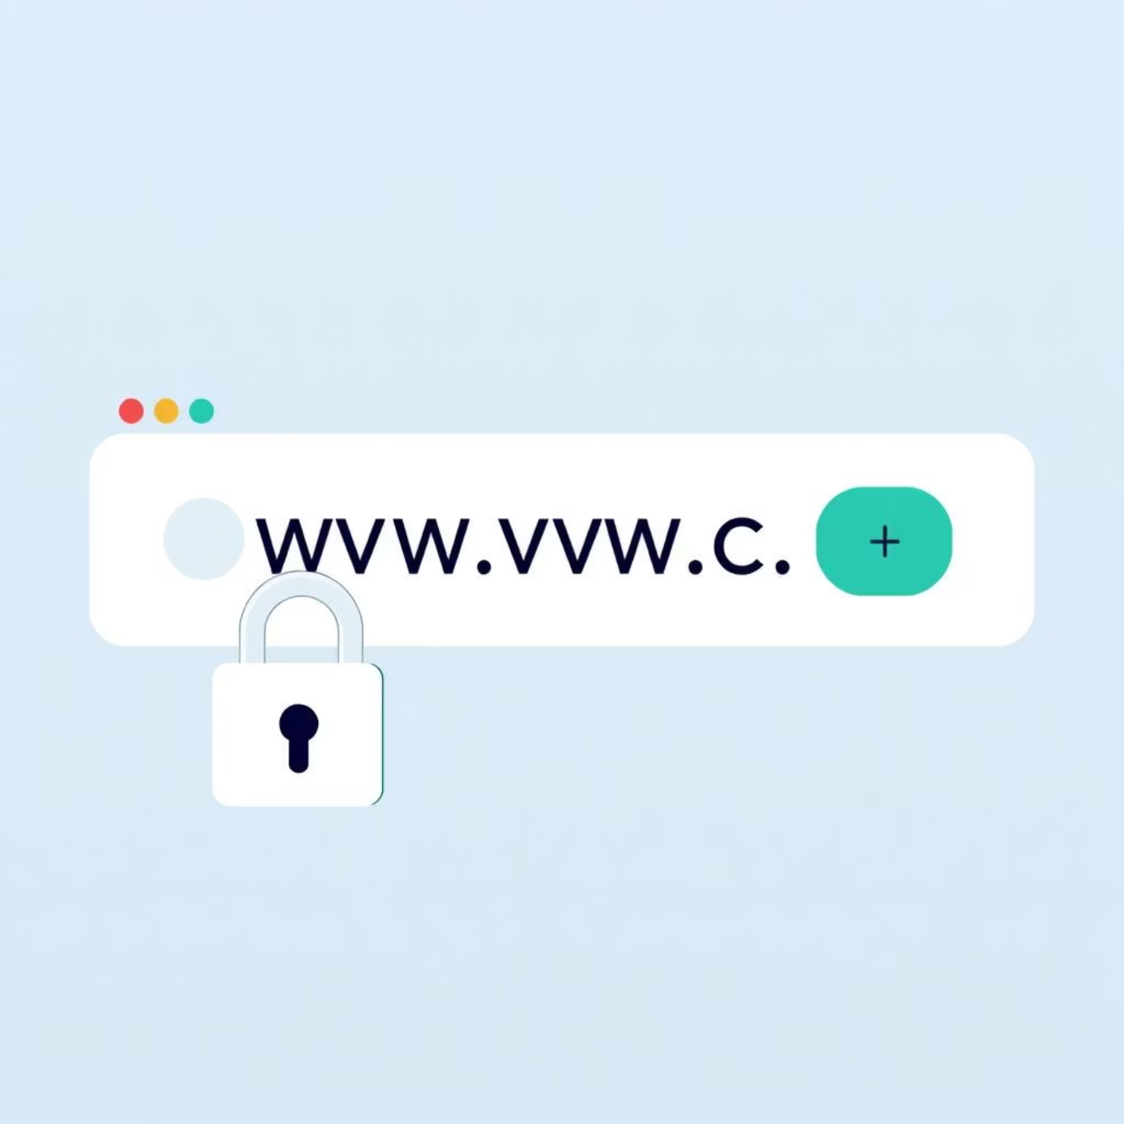

Common TLS Use Cases and Best Practices
TLS is ubiquitous across the digital landscape, securing critical services and maintaining user trust.
Real-World Applications of TLS
HTTPS (Port 443): Securing web traffic, protecting sensitive user data (login credentials, payments).
Email (SMTPS/IMAPS/POP3S): Encrypting mail transfer (e.g., port 465) and access protocols
(e.g., port 993).
VPNs and Remote Access: Ensuring confidentiality for secure tunnels and remote desktop
protocols (e.g., OpenVPN, WireGuard often use TLS).
APIs and IoT: Providing secure communication between microservices and protecting data
transmission from embedded devices.
Configuration Best Practices
Mandate TLS 1.3: Prioritize the latest, most secure, and most efficient protocol version.
Disable Legacy Ciphers: Remove support for SSL/TLS 1.0/1.1 and weak cipher suites (e.g., 3DES, RC4).
Avoid Weak ciphers such as RC4 or 3DES.
Enable Forward Secrecy by sing ECDHE for key exchange.
Renew certificates regularly, and make sure they use string key sizes like RSA 2048 or ECC.
Implement Forward Secrecy: Use Elliptic Curve Diffie-Hellman Ephemeral (ECDHE) for key exchange.
Regularly Renew Certificates: Ensure certificates are valid and use strong key sizes (e.g., RSA 2048 or ECC).

Slide 7

Thank You
We appreciate your time and attention to understanding the critical role of TLS in securing our digital world

